Slide 1
ENGLISH 9 FINAL EXAM VOCABULARY
STUDY – THEY WILL BE ON THE FINAL EXAM!!!!!

Slide 2
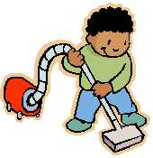
DUTIFULLY
Timmy dutifully did his chores every week in order to help out his mom and dad.
DUTIFULLY (ADV) WITHOUT PROTEST, OBEYING

Slide 3
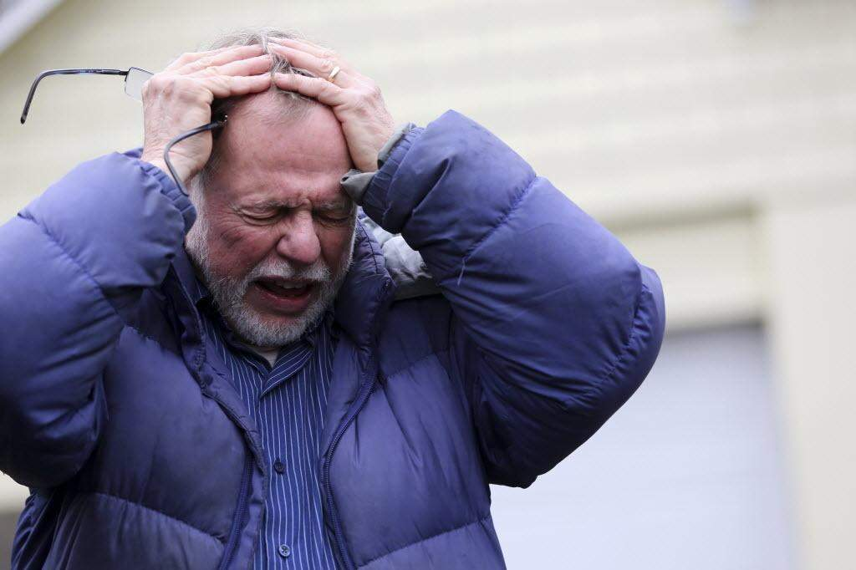
FRANTIC
Bob was frantic with worry when he realized he lost his grandson at the park.
FRANTIC (ADJ.) UPSET, DESPERATE, AGITATED, EXTREME WORRY

Slide 4
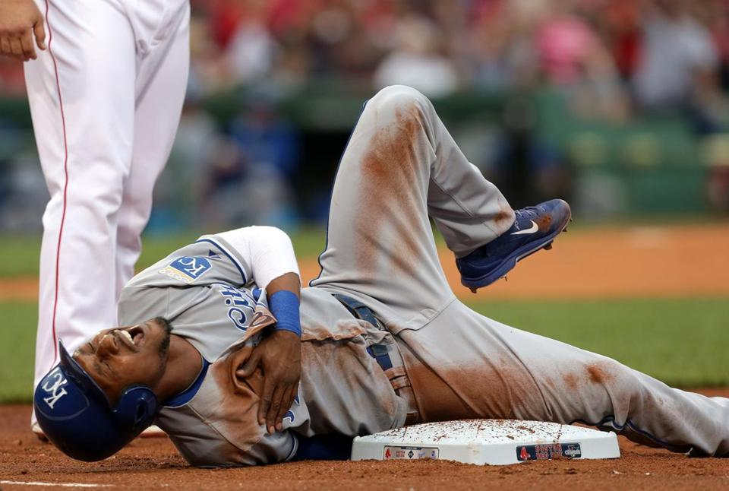
WRITHED
The batter writhed in pain when the ball hit him in the chest going and breathlessly knocked him down.
WRITHED (VERB) TWISTED AND SQUIRMED IN PAIN

Slide 5
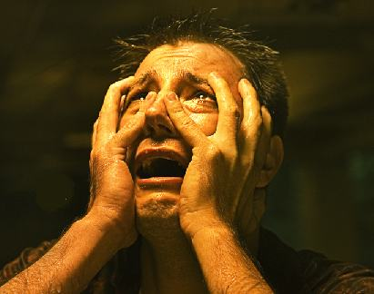
WOE
Tony experienced great woe in his life when he lost his family, friends and home because he could not stop gambling.
WOE (NOUN) GREAT TROUBLE AND GRIEF

Slide 6
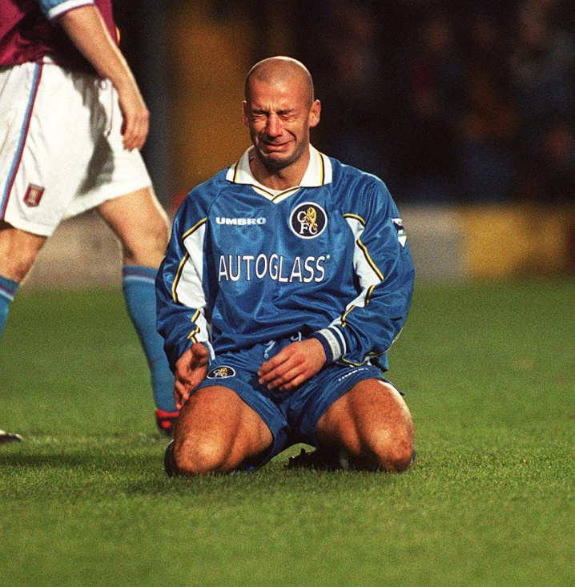
CRESTFALLEN
The goalie was crestfallen when he allowed the other team to score and they lost the championship game.
CRESTFALLEN (ADJ) DISAPPOINTED, DEPRESSED, SAD

Slide 7
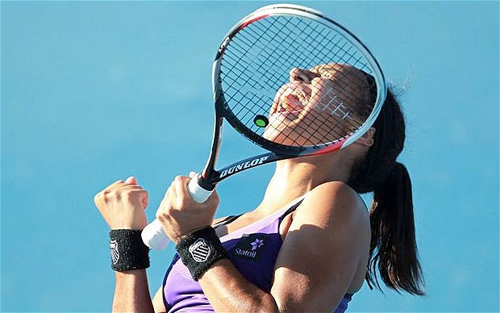
TRIUMPH
The tennis player cheered in triumph when she won her match and the title of the best player in the world.
TRIUMPH (NOUN) FEELINGS OF JOY AND HAPPINESS OVER A SUCCESS OR VICTORY

Slide 8
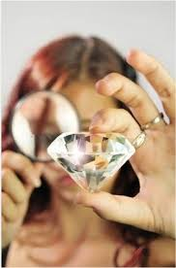
APPRAISED
Tina had her diamond appraised so she could get it insured for the correct amount of money.
APPRAISED (VERB) TO LOOK OVER AND MAKE A JUDGEMENT

Slide 9
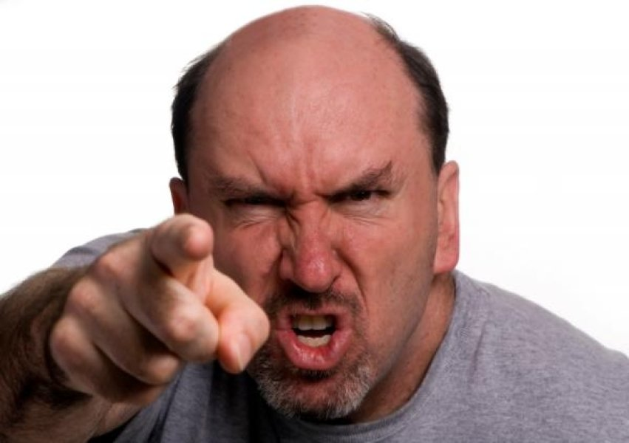
PUGNACIOUS
Bob’s pugnacious uncle was a bully and got into a fight every weekend of his life.
PUGNACIOUS: (ADJ) EAGER AND READY TO FIGHT, AGGRESSIVE

Slide 10
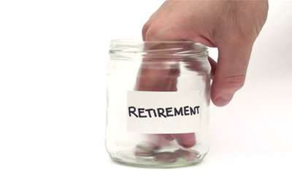
MEAGER
Bill did not plan for his retirement and only had a meager amount of money put aside when he got older and retired from his job.
MEAGER (ADJ) SMALL AMOUNT, NOT ENOUGH TO SATISFY

Slide 11
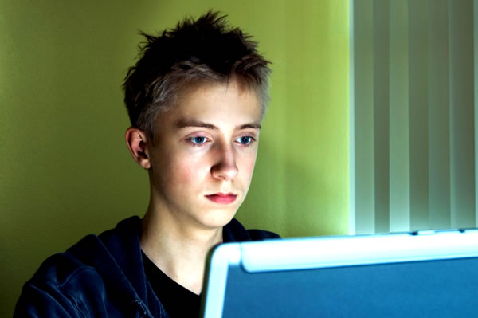
BEMUSED
A bemused Tony had spent the last 15 hours on his computer and did not even know his family went out to dinner without him.
BEMUSED (ADJ) LOST IN THOUGHT, PREOCCUPIED

Slide 12
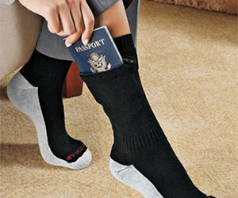
CONCEALING
Bob was so nervous when he traveled to Europe that he concealed his passport in his sock so it would not be stolen.
CONCEALING (VERB) HIDING SOMETHING OR SOMEONE

Slide 13
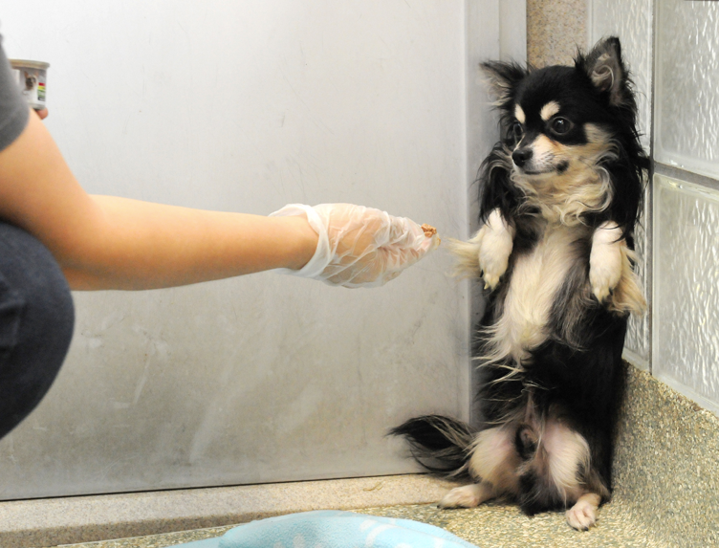
COWERING
The dog cowered in the corner after he was beaten by his former owner; even after he was saved by the veterinarian.
COWERING (VERB) TO BACK AWAY IN FEAR

Slide 14
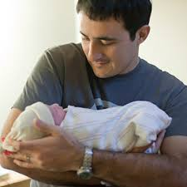
GINGERLY
Mike gingerly held his newborn son in the hospital and was so very nervous.
GINGERLY (ADV) VERY CAREFULLY

Slide 15
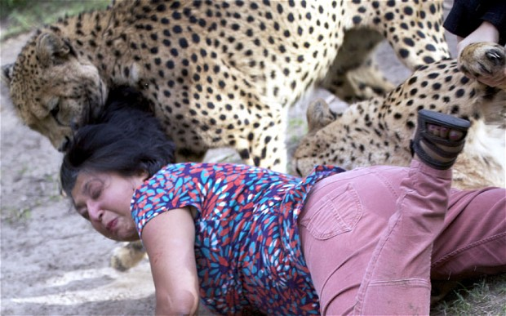
MAULED
The tourist was mauled by a cheetah during a safari in Africa.
MAULED (VERB) BEAT, BATTERED, OR TORE AT A PERSON OR ANIMAL

Slide 16
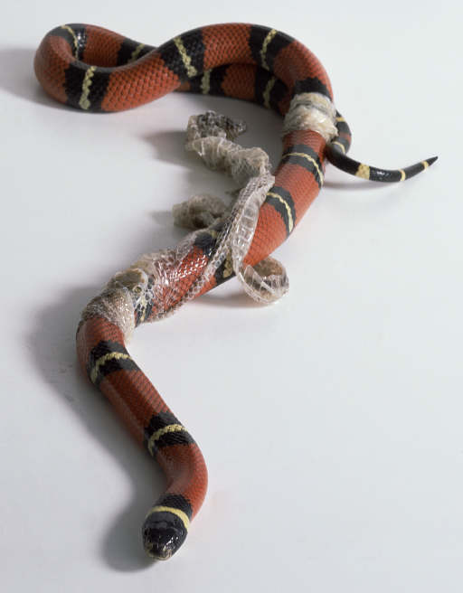
SLOUGH
Tim’s family did not want him to get a snake because the snake’s skin would slough off and then they would have to clean it up.
SLOUGH (VERB) TO SHED OR CAST OFF SOMETHING

